Slide 1
Intro to Machine Learning
Will Stanton
March, 2022

Slide 2
Topics
Who am I?
What is Machine Learning?
Applications of Machine Learning
Machine Learning Algorithms
What is Deep Learning?
The One Learning Algorithm Hypothesis
How Deep Learning Works
Deep Learning Frameworks
Other ML Frameworks
ML and Deep Learning in the Cloud
Getting Started on Your Own ML Project
Q and A

Slide 3
Who am I?
Will Stanton
Lead Machine Learning Engineer at Acorns (Formerly at Splunk, VictorOps, ReturnPath)
Masters in Math from CU Boulder
I live here in Boulder
I started with Data Analytics, then to Data Science / ML, now focused on ML Engineering

Slide 4

A Couple of Cool Demos
Word2Vec demo https://www.cs.cmu.edu/~dst/test/Word2VecDemo/
How does a computer generate pictures of cats? https://affinelayer.com/pixsrv/
How does a computer learn to win at rock-paper-scissors? https://www.afiniti.com/corporate/rock-paper-scissors
TensorFlow playground (mess around with neural networks)

Slide 5

What is Machine Learning?
Machine Learning (ML) is the “the scientific study of algorithms and statistical models that computer systems use to effectively perform a specific task without using explicit instructions, relying on patterns and inference instead” (Wikipedia)
Different from most algorithms, in which the steps are explicitly programmed
ML algorithms “learn” from data
How is ML different from Artificial Intelligence (AI)?
ML is considered a (limited) form of AI
In the tech industry, ML and AI are often used interchangeably

Slide 6
Applications of Machine Learning
Common Applications
Chatbots (Google Assistant, Siri, Alexa)
Recommender Systems (“Customers Like you Bought This”, Netflix Movie Recommendations)
Forecasting (“You Should Buy This Stock”, “You Should Not Buy This Cryptocurrency”)
Reinforcement Learning (AlphaGo, Self-Driving Cars)
Image Recognition (“This Picture Contains a Cat”)
Automated Language Translation
Other Applications
Automated Security Breach Detection and Remediation
Law Enforcement and National Security Applications
Cell Phone Battery Life Optimization
...

Slide 7
Machine learning is everywhere
Someone is doing machine learning using you and your data right now

Slide 8
Fundamental Concepts of ML
Model: the algorithm itself (e.g. “Logistic Regression”) or the object you get after training a model
Training vs. Inference:
Training a model is applying the learning algorithm of the model to a set of data. For example, you could train an “Is this a dog” image recognition model on a labeled training set of 1000 images.
Inference is applying a trained model to a new observation. For example, you could apply your trained image recognition to an unlabeled image, and the model returns “This is a dog.”
ML Evaluation: Measuring how well a model is performing
Typically requires splitting data into training data, test data, and validation data. Often involves cross-validation.
Overfitting: Inadvertently learning patterns that do not generalize
Features: The inputs to the model (akin to “independent variables” in linear regression)
Notes:
Example of overfitting

Slide 9
Major Classes of ML Models
Supervised Learning: Training a model to predict a label or a value, based on a labeled training set (Classification and Regression are most common types of Supervised Learning)
Unsupervised Learning: Training a model without labels (Clustering and Dimensionality Reduction are examples)
Reinforcement Learning: Training a model to maximize some “reward” by taking actions in some environment (AlphaGo is an example)

Slide 10
Some Common Machine Learning Algorithms
Linear Regression: not exactly ML, but shares some characteristics
Logistic Regression: like linear regression for classification
K Nearest Neighbors Classifier: look for the k training examples that are closest to the new sample
Decision Trees (and Random Forest): greedily generate a tree (or many trees) that represent the patterns in the training data
K Means Clustering: a simple, fast, scalable clustering algorithm
Artificial Neural Network: fits the data according to a network of artificial “neurons”

Slide 11
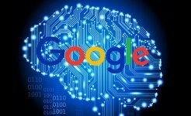
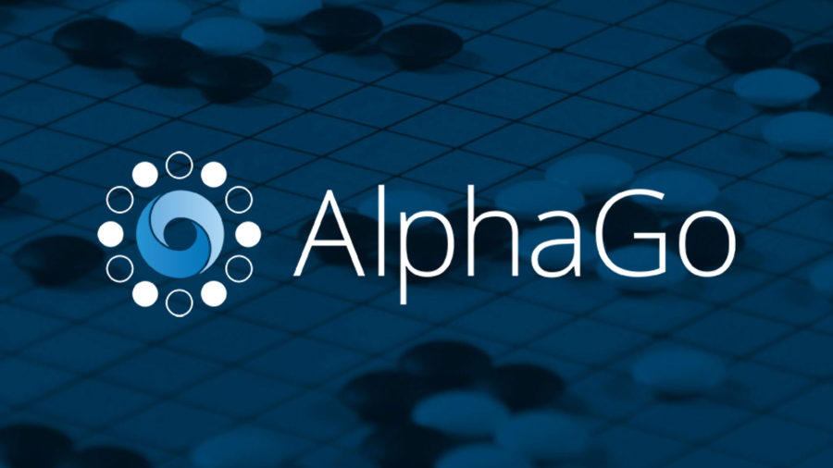
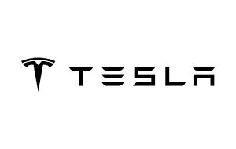
What is Deep Learning?
Deep Learning is the use of Artificial Neural Networks (ANNs) with many hidden layers
Loosely modeled on how the human brain works
State of the art for machine translation, image recognition, speech recognition tasks (and more)

Slide 12
The One Learning Algorithm Hypothesis
One Learning Algorithm Hypothesis: The theory that the brain uses the same neural learning architecture and algorithm to learn a variety of things
How do we know?
Experiments “rewiring” the vision and sound centers of animal brains
In humans: “seeing” with your tongue, feeling the direction North
Deep learning neural nets perform well on image recognition, speech recognition, text processing, language translation, sequence prediction, etc.
Generic deep learning algorithms can outperform “traditional” specialized algorithms
This is a big reason why deep learning is hyped so much
Andrew Ng (Stanford, Coursera, Google Brain, Baidu) lecture notes: http://cs229.stanford.edu/materials/CS229-DeepLearning.pdf
Notes:
No free lunch theorem?

Slide 13
How a Neural Network Works
Inputs enter first hidden layer “neurons”, and are transformed by activation function, then passed to second hidden layer, and transformed again by activation function, then passed to output layer (like function composition)
Cost function calculated based on outputs
Parameters of activation function adjusted to reduce value of cost function. This is called gradient descent.
Process repeated until gradient reaches small enough tolerance (ie. cost function stabilizes)
Inputs
x = (x1, x2, x3)
Output y
Output
Layer
Input Layer
Second Hidden Layer
First Hidden Layer
Notes:
Need a picture of newton’s method (gradient descent)

Slide 14
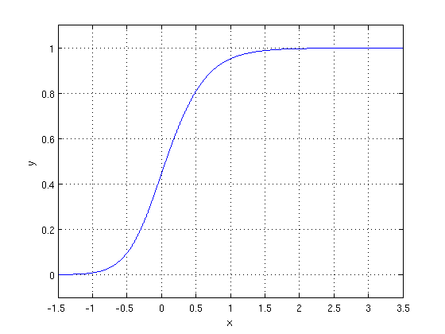
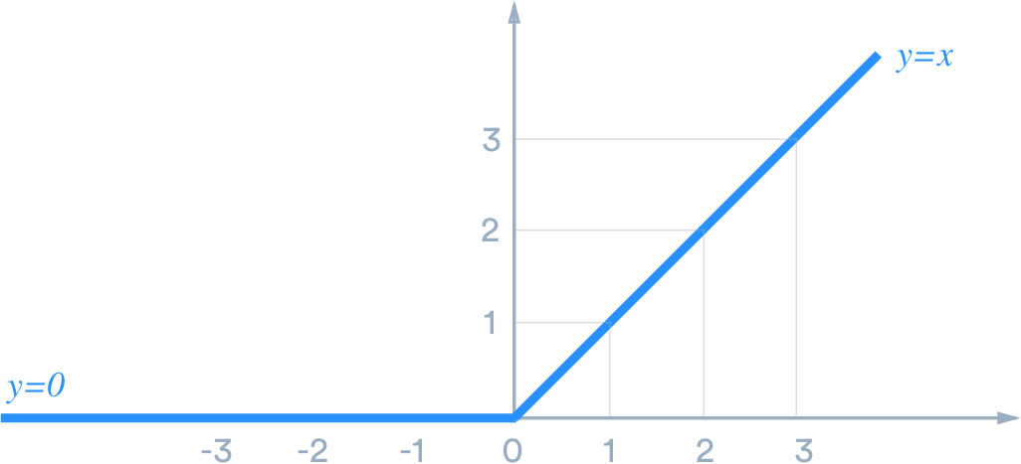
Activation Functions and Cost Functions
Activation Function (one at each node of each hidden layer):
logistic function: f(x) = 1/(1 + exp(-x))
x = w_1 x_1 + w_2 x_2 + … + w_n x_n (weighted sum of inputs from previous layer) parameters: w_1, …, w_n
ReLU (rectified linear units): approx. linear combo of logistic functions
prevents “problem of vanishing gradient” in gradient descent
Cost Function:
The function that measures how “bad” the algorithm is with a certain set of parameters
Appropriate cost function depends on the problem and the particulars of the the neural network
In supervised learning, often Root Mean Squared Error (RMSE) = sqrt(mean((outputs - labels)^2))
Gradient Descent
Gradient Descent is a method that attempts to minimize the cost function using the gradient of the cost function with respect to the parameters
Notes:
Pictures of logistic/ReLU activation functions

Slide 15
Training a neural network is about minimizing the cost function*
*There are lots of ways to do this, and lots of ways for it to go wrong

Slide 16
Demo of Different Types of Neural Network Architecture
TensorFlow Playground (playground.tensorflow.org)
Class Participation!

Slide 17


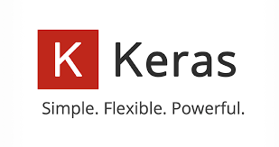
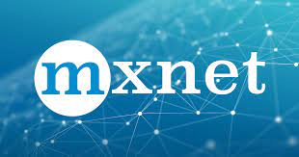
Deep Learning Frameworks
TensorFlow: Probably the most popular. Integrated with Google Cloud. Capable of running on many different platforms, including on phones and in webpages (Tensorflow.js)
Keras: High level Python package for neural networks. Can use TensorFlow or Theano as the underlying computational system
Tensorflow 2.0 incorporates Keras API
PyTorch: Also extremely popular
Many others:
Caffe, Cognitive Toolkit, Chainer, MXNet

Slide 18
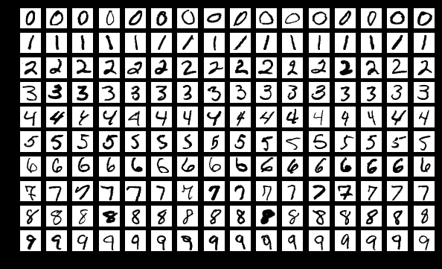
TensorFlow 2.0 Demo
It’s not too hard to get started!
Demo link
Using MNIST handwritten digit recognition dataset
Can we train a neural network to recognize which digit the person wrote automatically?
Great to get started with datasets from Kaggle
Kaggle has data science competitions
Hosted Jupyter notebooks solution
Great ML tutorials for free
Another option: Google Colab
Hosted Jupyter notebooks with dependencies, pre-installed, sample notebooks, and free GPU support
https://en.wikipedia.org/wiki/MNIST_database

Slide 19

Keras: Simple Deep Learning in Python
Keras is a library for deep learning with Python
Uses Tensorflow or Theano for underlying neural network computations
Easy to use API
Easy to get started
Good place to start if you know Python
https://keras.io/
Notes:
Keras example code

Slide 20
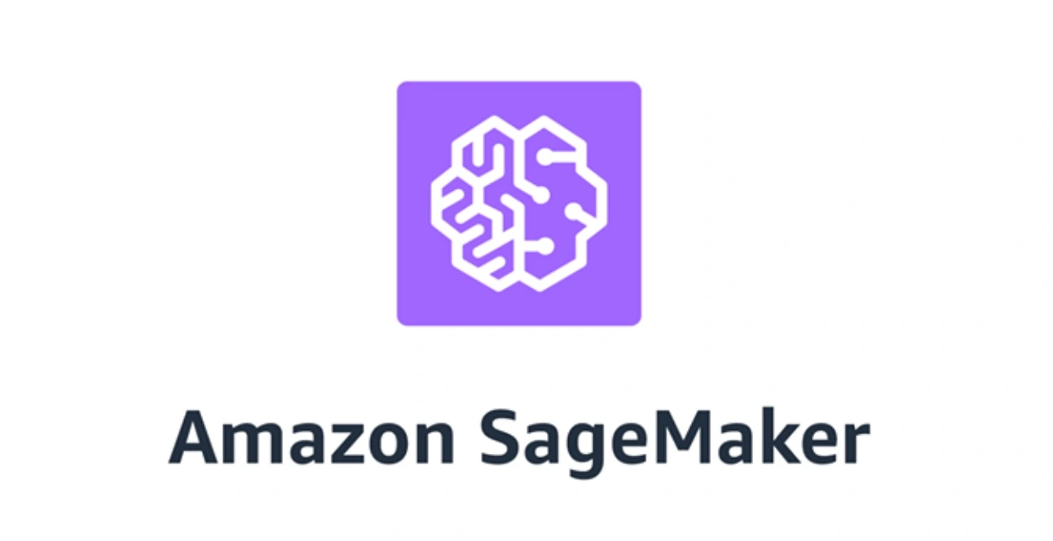
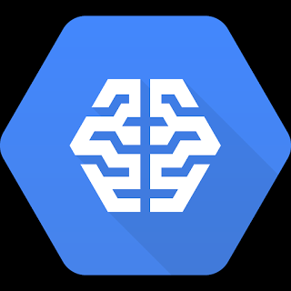
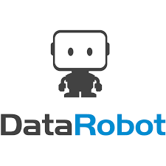
Deep Learning and ML in the Cloud
All major cloud providers offer a few different options for deep learning and ML in the cloud
Roll your own: Virtual machines for computation: GPU and/or CPU (e.g. AWS EC2 or Google Compute Engine)
Cloud Provider ML Platforms: Runtimes that integrate with existing frameworks and offer “easy” creation of API endpoints, serialization of models, high availability configuration (e.g. AWS Sagemaker or Google Cloud ML Engine)
AutoML / Point and Click: Drag and drop interface, limited model flexibility, super easy training and deployment. (e.g. Amazon Machine Learning or Google Cloud AutoML Vision).
ML as a Service: Pretrained models, limited customizability. Just call an API. Can be expensive! (e.g. AWS Rekognition or Google Cloud Vision API)
SaaS Vendors: Provide platforms and/or services for ML. E.g. DataRobot, Databricks

Slide 21
Other ML Frameworks
Deep Learning is not the (only) answer
Sometimes, simpler techniques are easier to implement, easier to interpret, and could even perform better
Especially non-”deep” tasks. Deep learning might overfit!
A few other options:
Python scikit-learn: general purpose, easy to use
Spark.ml or Spark MLLib: integrated with Apache Spark
Python gensim: topic modeling, document similarity (also does word embeddings like word2vec, so you can make a computer solve analogies!)

Slide 22
Which ML Framework to Use?
If you’re going to learn one, learn TensorFlow or PyTorch
Probably doesn’t matter which one you start with
You will need to learn some of the Python Scientific Stack for data manipulation and helper functions
Scikit-learn, pandas, numpy
Courses to try
Coursera Deep Learning (deeplearning.ai) for Tensorflow
Fast.ai for PyTorch

Slide 23
Getting Started on Your Own ML Project
Think about
What data do I have?
What value am I trying to provide?
Different approaches using different cloud services:
Simplest: Use a canned machine learning as a service system e.g. Google Cloud Vision (just send an image to a REST API endpoint and get info back)
In-between solution: Use Sagemaker or Google Cloud ML Engine. Requires you to create training and validation datasets, but makes deployment in production relatively easy
For people who like installing Linux dependencies: Create training and validation datasets, write code using TensowFlow or similar, test a few different models, deploy it yourself. (Use Flask or another API framework to create an API)

Slide 24
One more demo
Automated sentence completion in the style of famous people: https://cyborg.tenso.rs/

Slide 25
Just like any other software, ML provides the most value when you deploy it!

Slide 26
Q and A

